Slide 1

Rockbuster Stealth Online Launch Initiative
Alejandro Cisneros
February 5th, 2024

Slide 2
Strategic Scope and KPI’s
Project consisted of analyzing all sales data from 2019 to leverage data driven insights with strategic planning to segue the company into the e-commerce landscape
KPI’s to track in real time moving forward based on pre-defined objectives in BRD
KPI1: Customer Distribution by Country
KPI2: Top Revenue-Generating Movies
KPI3: Sales Variation by Geographic Region
KPI4: High Lifetime Value Customer Concentration
KPI5: Sales Variation by Geographic Region

Slide 3


Data Overview

Slide 4
FY19 Global Exploratory Data Analysis
Gross Revenue | $61,312
# Customers | 599
# Rentals | 16,044
# Countries | 109
# Movies | 1,000
Categories | 17
Most Popular Category | Sports
Ratings | G, PG, PG-13, R, NC-17
Most Popular Rating | PG-13
 | Rental Rate | Rental Duration | Rental Replacement Cost | Film Length
Min | $.99 | 3 days | $9.99 | 46 minutes
Max | $4.99 | 7 days | $19.98 | 185 minutes
Average | $2.98 | 5 days | $29.99 | 115.3 minutes

Slide 5
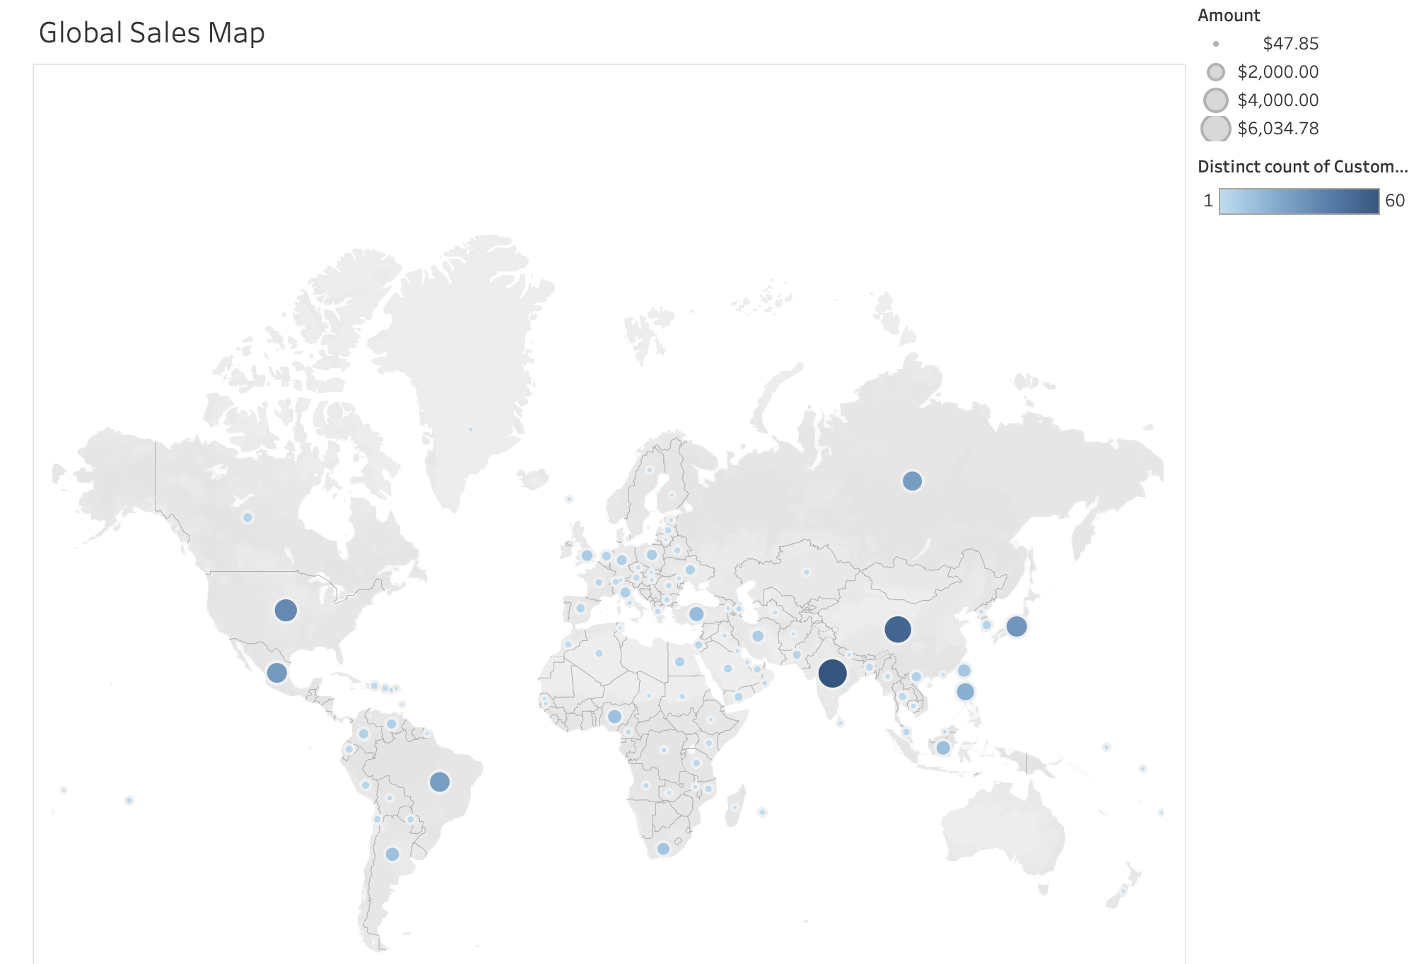
FY19 Key Performance Indicator 1 –
Customer Distribution by Region/Country
India (60 customers)
China (53 customers)
United States (36 customers)
Japan (31 customers)
Mexico (30 customers)

Slide 6
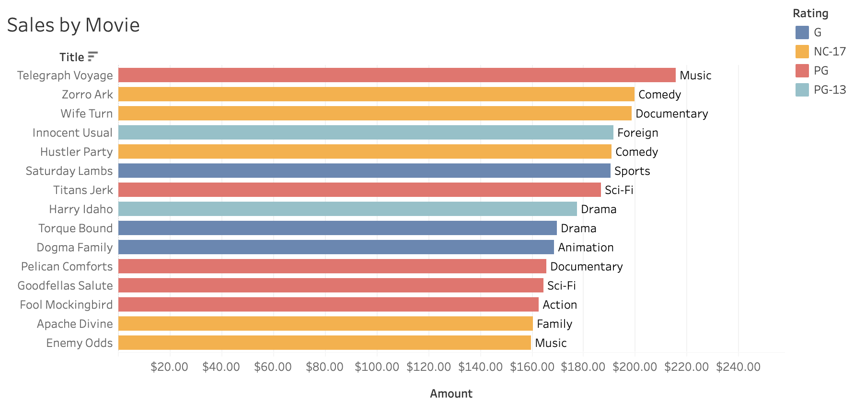
FY19 Key Performance Indicator 2 –
Top Revenue-Generating Movies
Breakdown of Top 15 Movies in Revenue Generated:
Rating
G: 3
PG: 5
PG-13: 2
R: 0
NC-17:5
Genre
Action: 1
Animation: 1
Comedy: 2
Documentary: 2
Drama: 2 Family: 1
Foreign: 1
Music: 2
Sci-Fi: 2
Sports: 1

Slide 7

FY19 Key Performance Indicator 3 –
Average Rental Duration
The average rental duration for all films was 4.99 days.

Slide 8
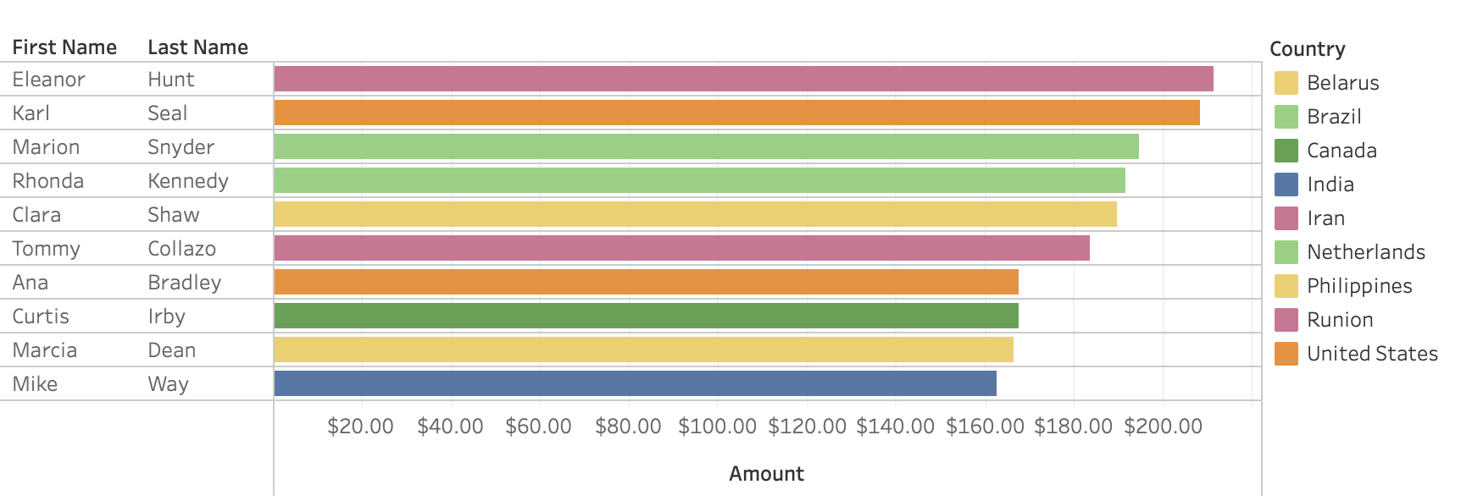
FY19 Key Performance Indicator 4 –
High Lifetime Value Customer Geo-Concentration

Slide 9
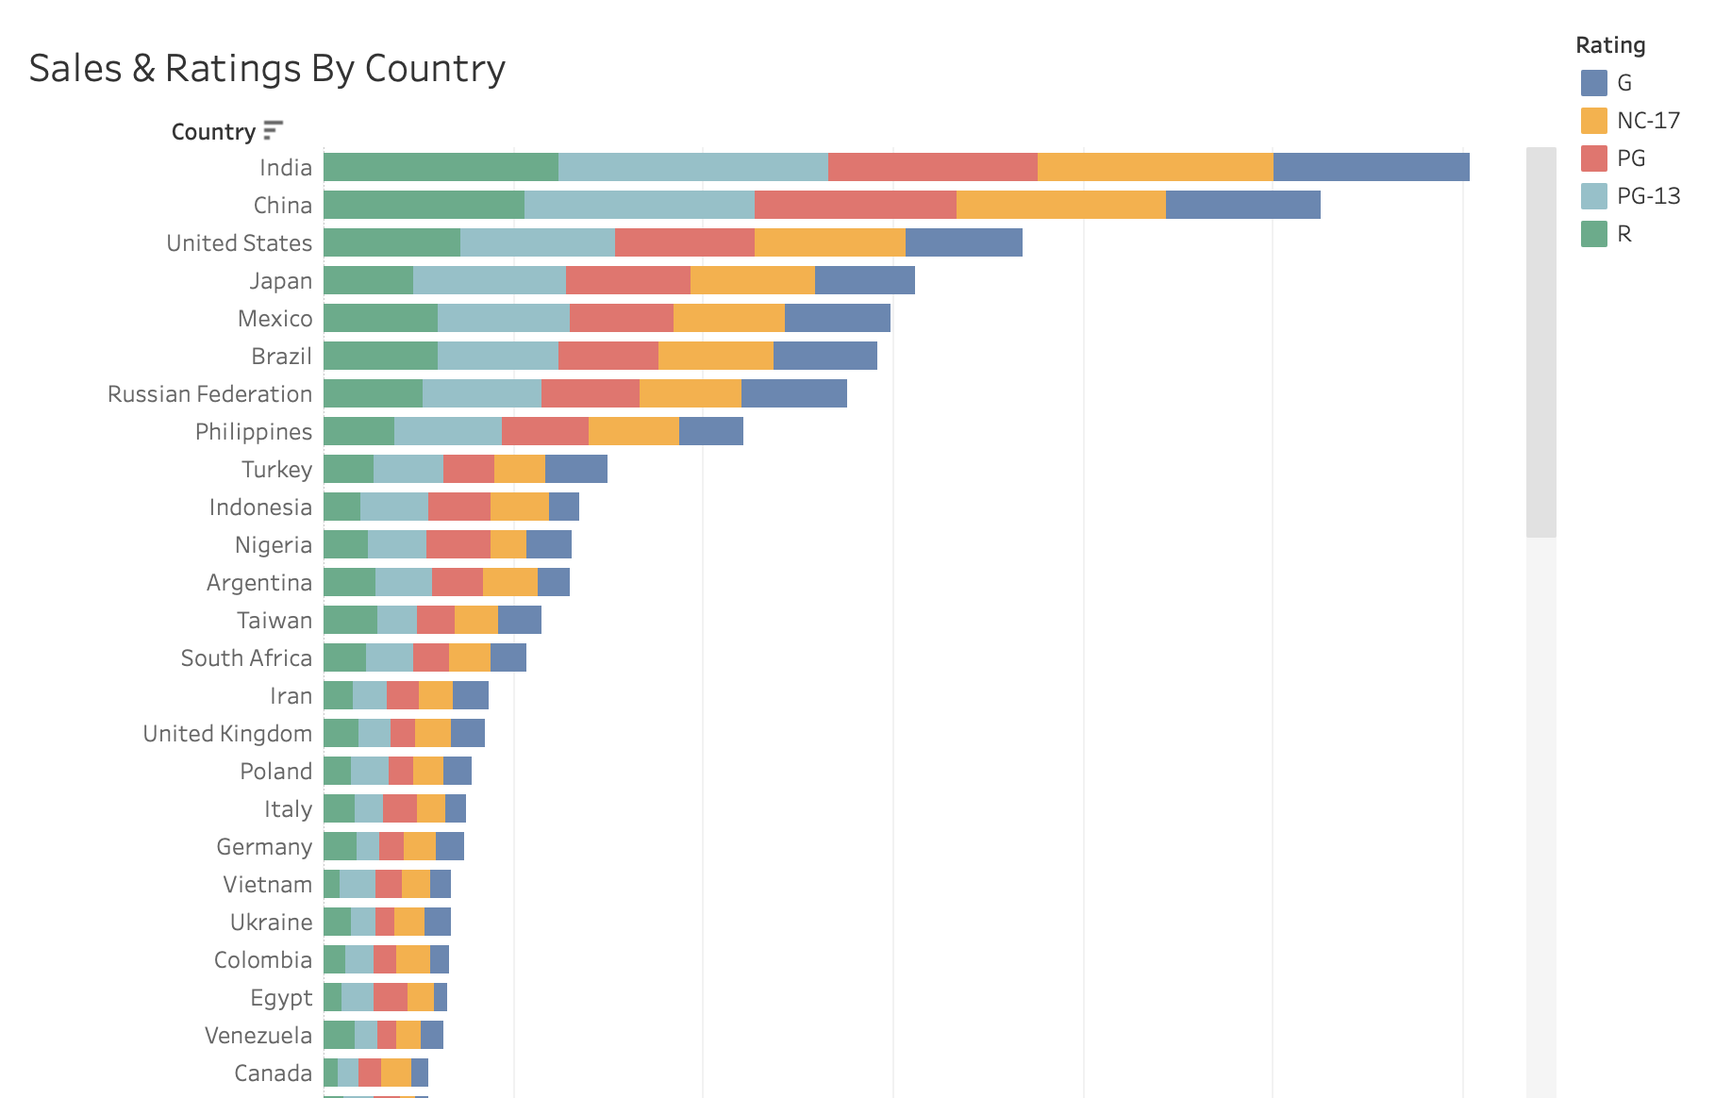
FY19 Key Performance Indicator 5
Sales Variation by Geographic Region
Asia dominated the Top 10 countries by revenue generated, placing 6 of the 10 countries.

Slide 10
Action Path

Slide 11
Recommendations
Create a marketing strategy tailored for each of the top 5 highest grossing countries
Discounts or coupons offering x % off when signing up for online account
Special pricing structure for HLVC (High Lifetime Value Customers)
Eliminate waste by discontinuing any movies who grossed less than $14.15, as the cost of maintaining exceeds the revenue they generate.
Strategically advertise and/or discount highest grossing movies throughout the year to engage new customers and enhance customer retention

